Slide 1


GAYATRI VIDYA PARISHAD COLLEGE FOR DEGREE AND PG COURSES (A)
DEPARTMENT OF COMPUTER SCIENCE
DESIGN OF PORTABLE LAND PARAMETER MEASURING DEVICE ON MACHINE LEARNING USING IoT
By
D.PRASANTH KUMAR
PG232406003
(2023-25)
SEM-IV
Project Guide:
Mr.B.DIVAKAR
Assistant professor

Slide 2
CONTENTS
ABSTRACT
INTRODUCTION
CURRENT SYSTEM
PROBLEM STATEMENT
PROPOSED SYSTEM
ALGORITHM WITH EXAMPLE
FLOW DIAGRAM
COMPONENTS
FEATURES OF THE PROJECT
CONCLUSION

Slide 3
ABSTRACT
The Portable Land Parameter Measuring Device integrates machine learning (ML) to enable real-time monitoring of critical soil and environmental parameters (moisture, pH, temperature, EC, ambient temperature, humidity) in remote field conditions. Designed for farmers, researchers, and land managers, it combines capacitive, thermistor, and conductivity sensors controlled by a microcontroller. The lightweight, weatherproof device features a solar-rechargeable battery, OLED/LCD display, and Bluetooth/Wi-Fi connectivity for data transfer. By providing actionable insights through embedded ML algorithms, it supports precision agriculture, optimizes resource use, and enhances sustainable land management. This cost-effective, user-friendly solution bridges the gap between manual field analysis and smart, data-driven decision-making.

Slide 4
INTRODUCTION
The Internet of Things (IoT) refers to a network of interconnected physical devices ranging from everyday household items to sophisticated industrial machinery that communicate and exchange data over the internet. These devices are embedded with sensors, software, and other technologies, enabling them to collect and share information without human intervention. This connectivity allows for real-time monitoring, control, and automation across various sectors, including healthcare, transportation, and home automation. The proliferation of IoT has led to smarter environments and enhanced decision-making processes, transforming how we interact with the world around us.

Slide 5
CURRENT SYSTEM
1.Lab-Based Analysis :
Current systems often involve collecting soil samples and transporting them to a laboratory for analysis. This process is time-consuming, expensive, and may not provide real-time insights.
2.Specialized Equipment :
Traditional land parameter measuring equipment is typically bulky and expensive, requiring specialized knowledge and expertise for operation and data interpretation.
3.Limited Portability :
The size and complexity of existing equipment often restricts its portability, making it difficult to monitor land parameters in remote or field locations.

Slide 6
PROBLEM STATEMENT
Challenges in Land Monitoring :
Traditional land parameter measurement methods often involve bulky and expensive equipment, requiring specialized expertise and laboratory analysis. This makes it challenging to monitor soil and environmental conditions in remote or field locations, hindering informed decision-making for agriculture and land management
Need for Real-Time Data :
The need for real-time data on soil moisture, pH, temperature, and other parameters is critical for optimizing irrigation, fertilization, pest control, and crop yield. Farmers, environmental scientists, and researchers require a user-friendly and cost-effective solution for accurate land parameter measurement.

Slide 7
PROPOSED SYSTEM
Compact and Portable:
Our proposed device is designed to be compact, lightweight, and ruggedized for easy transportation and use in diverse field conditions. It incorporates a range of sensors for measuring soil moisture, pH, temperature, electrical conductivity, and ambient conditions.
Real-Time Monitoring:
The device provides real-time data readings displayed on a built-in LCD screen and can be wirelessly connected to smartphones, tablets, or computers for data analysis and remote monitoring.

Slide 8
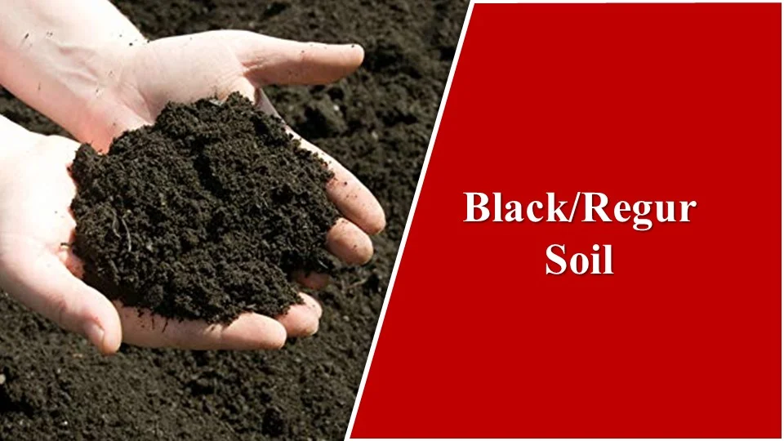
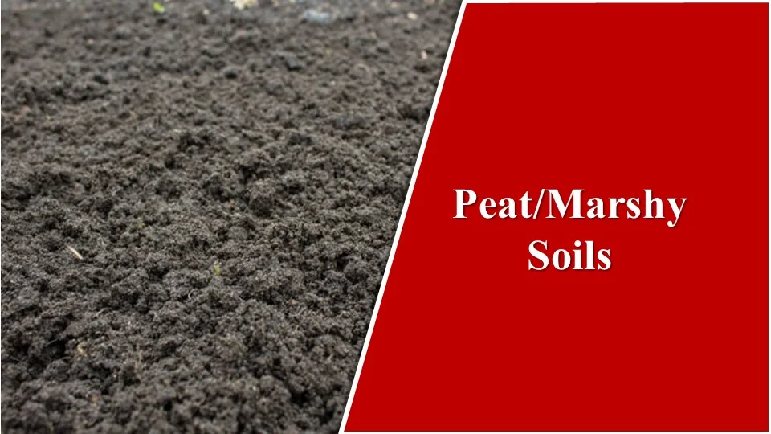
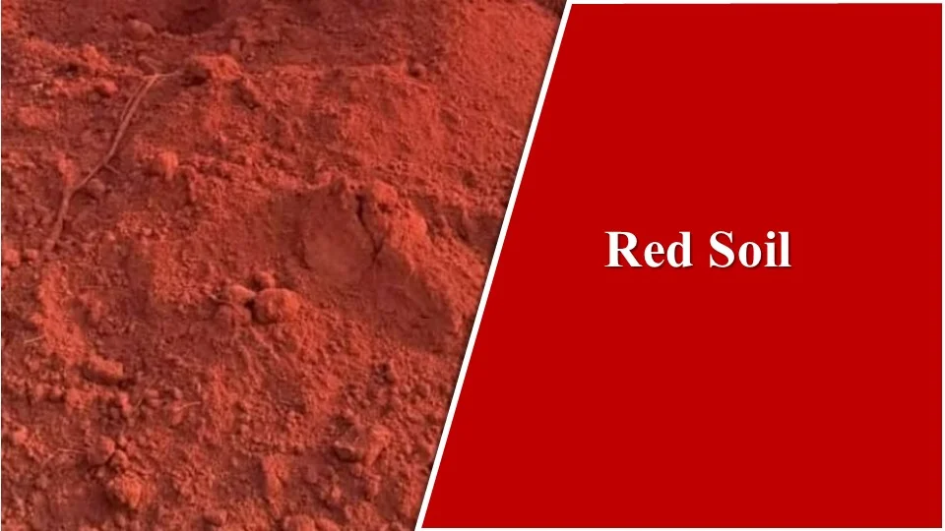
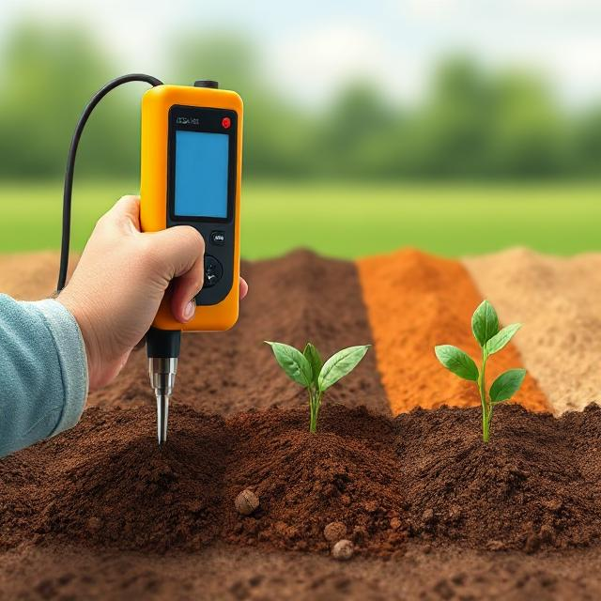
Monitoring Soil Health Across Different Soil Types

Slide 9
ALGORITHMS
Regression Models:
Predicts crop yield by analyzing soil moisture, temperature, and nutrient levels.
Helps in optimizing irrigation and fertilization schedules.
Classification Algorithms:
Identifies soil types based on pH, EC, and moisture levels.
Detects disease risks, such as fungal outbreaks linked to humidity and pH imbalances.
Recognizes environmental contaminants from abnormal EC readings.
Machine Learning Integration:
Processes real-time sensor data for adaptive decision-making.
Enhances precision agriculture by minimizing resource waste.
Can function on-device or via cloud platforms for better accessibility.
These algorithms help in automating soil analysis, optimizing crop health, and improving sustainability in land management.

Slide 10
ALGORITHMS WITH EXAMPLE
1. Regression Analysis
Purpose: Predict numerical outcomes (e.g., crop yield, irrigation needs). Example:
Model: Random Forest Regression
Input Features: Soil moisture (%), temperature (°C), EC (µS/cm), pH.
Output: Predicted crop yield (kg/ha).
Application:
Trained on historical data (e.g., 5 years of farm data).
Example Prediction: Input: Moisture=65%, Temp=25°C, EC=1200 µS/cm, pH=6.5 → Output: Yield=4200 kg/ha.
2. Classification Models
Purpose: Categorize data into classes (e.g., soil type, disease risk). Example:
Model: Support Vector Machine (SVM)
Input Features: EC, pH, ambient humidity.
Output: Soil type (e.g., "Sandy Loam," "Clay").
Application:
Classify soil for fertilizer recommendations.
Example Classification: Input: EC=800 µS/cm, pH=5.8, Humidity=70% → Output: "Loamy Soil."

Slide 11
3. Anomaly Detection
Purpose: Identify outliers (e.g., sensor errors, contamination). Example:
Model: Isolation Forest
Input Features: Sensor readings (pH, EC) over time.
Output: Anomaly score (0=normal, 1=anomaly).
Application:
Detect sudden pH spikes (e.g., >8.5) indicating contamination.
Example Alert: Input: pH=9.2 → Output: "Contamination Risk! Verify soil samples."

Slide 12
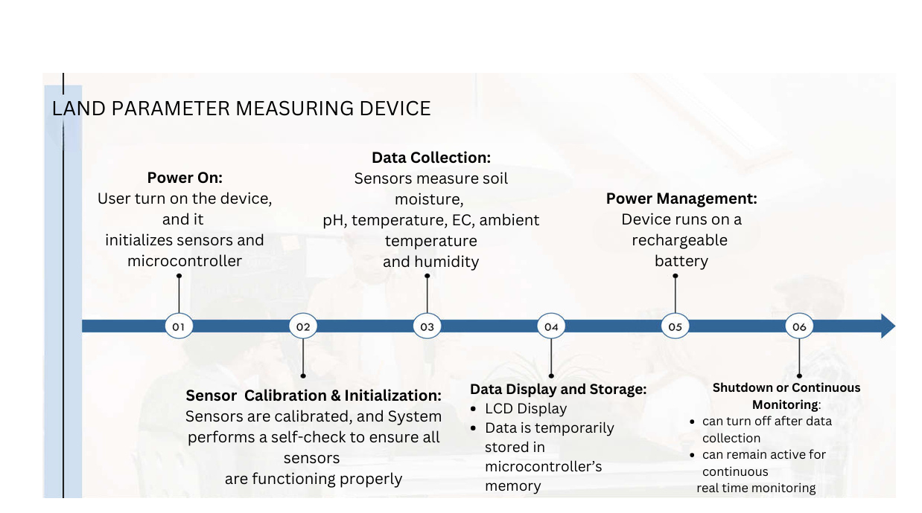
BLOCK DIAGRAM
FLOW DIAGRAM

Slide 13
COMPONENTS :
1. Microcontroller
2. Capacitive Soil Moisture Sensor
3. Soil pH Sensor
4. Soil Temperature Sensor
5. Electrical Conductivity (EC) Probe
6. Ambient Temperature & Humidity Sensor
7. Display Unit
8. Power Supply
9. Enclosure & Additional Components

Slide 14
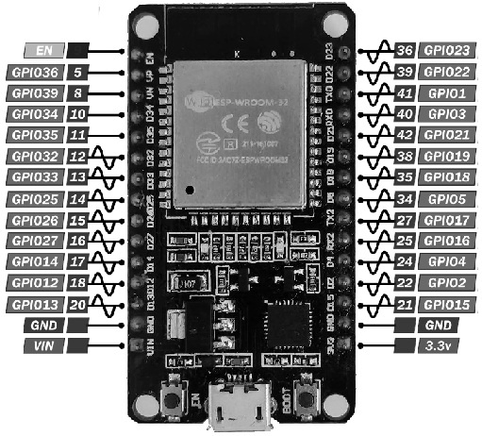
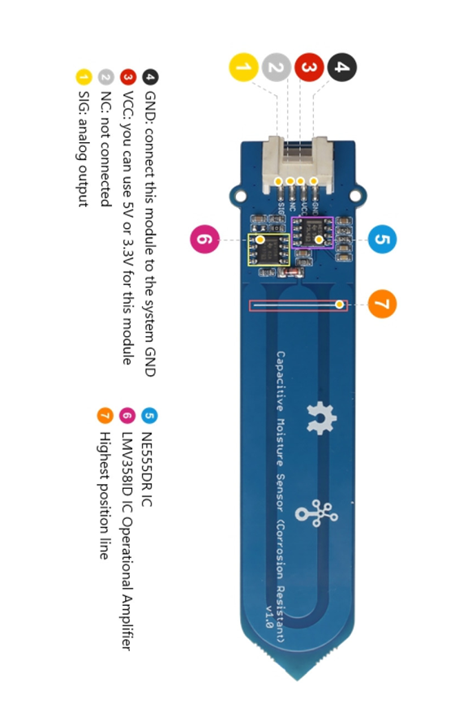
COMPONENTS :
1. ESP32 Microcontroller – A small computer that controls sensors and processes data.
Use: Collects sensor data, processes it, and sends it wirelessly via Wi-Fi/Bluetooth.
2. Soil Moisture Sensor – Measures water content in the soil.
Use: Helps farmers decide when to water crops, preventing overwatering or dryness.

Slide 15
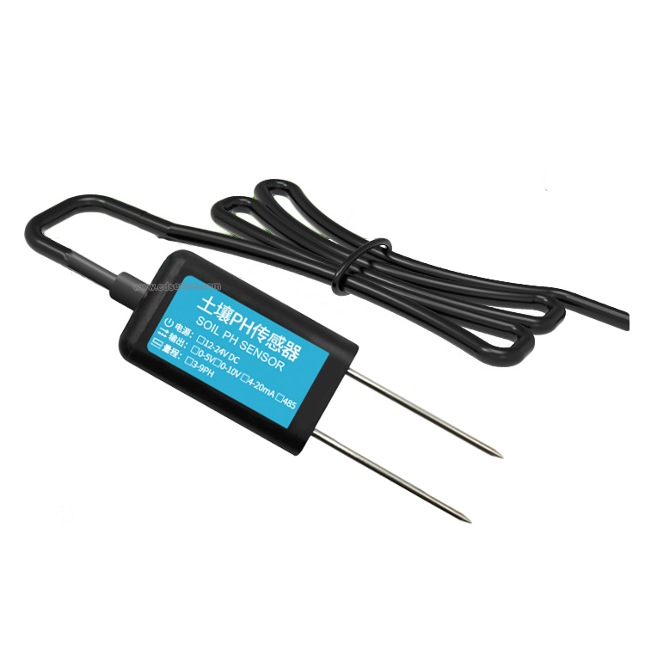
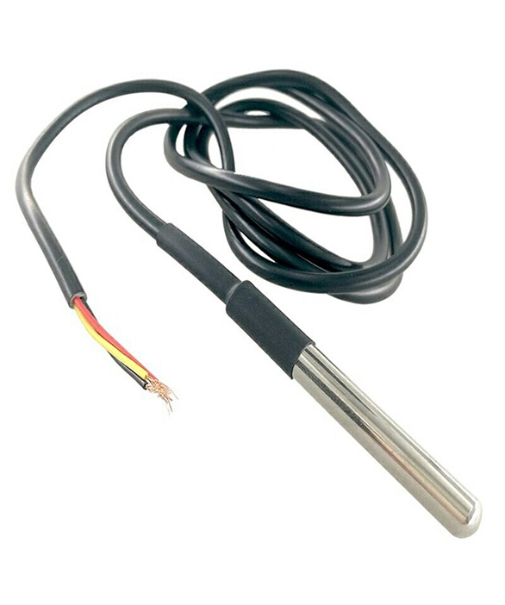
COMPONENTS :
3. Soil pH Sensor – Detects if the soil is acidic or alkaline.
Use: Ensures soil has the right pH for proper plant growth and nutrient absorption.
4. Soil Temperature Sensor – Checks the temperature of the soil.
Use: Helps in planting crops at the right time and managing soil conditions.

Slide 16
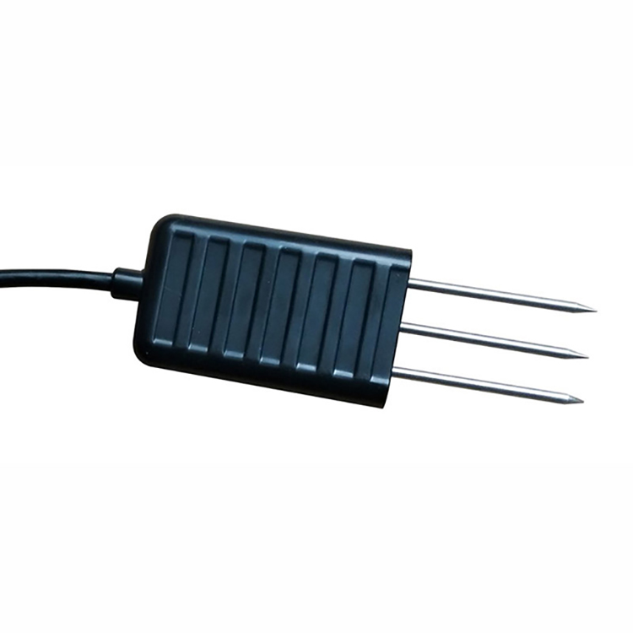
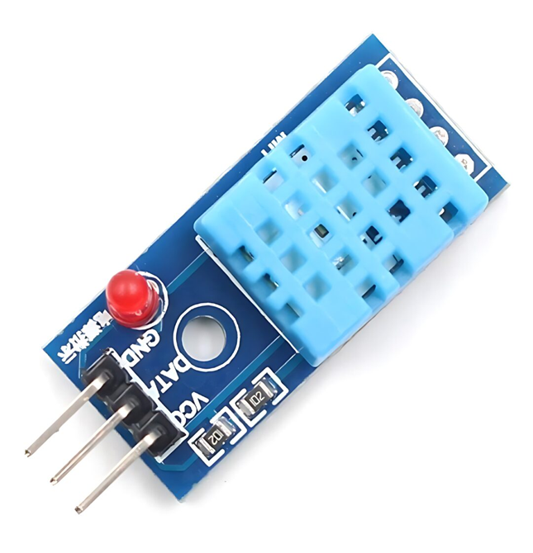
COMPONENTS :
5. Electrical Conductivity (EC) Probe – Measures salt and nutrient levels in the soil.
Use: Helps in detecting soil fertility and preventing excess salt buildup.
6. Humidity & Temperature Sensor – Detects air moisture and temperature.
Use: Helps in monitoring weather conditions and preventing plant diseases.

Slide 17
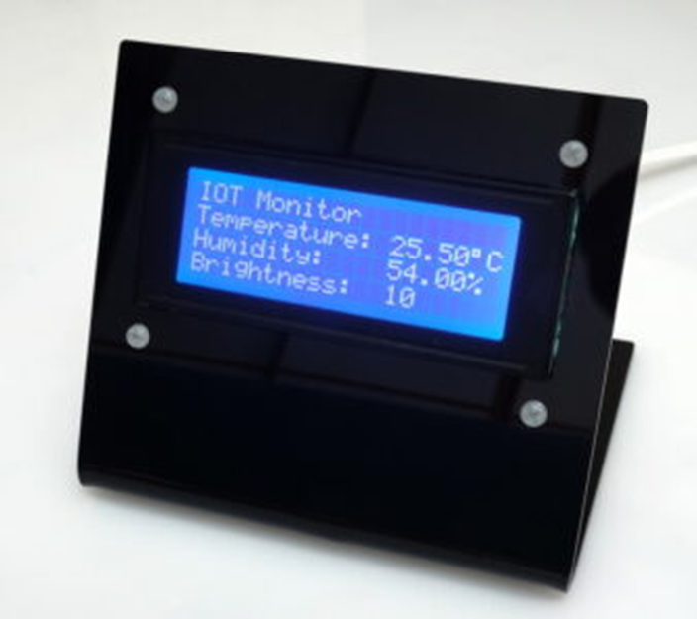
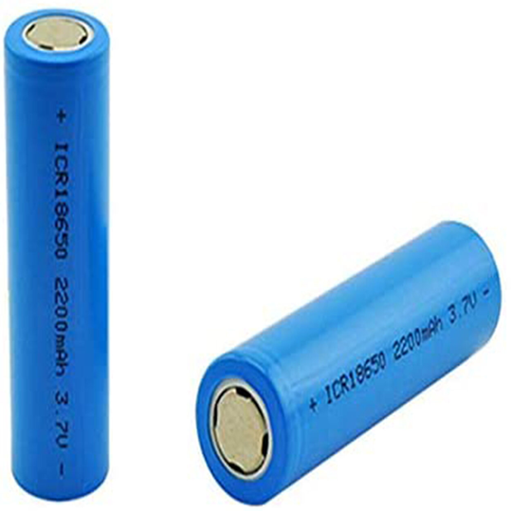
COMPONENTS :
7. Display – A screen that shows information.
Use: Displays real-time soil and environmental data for the user.
8. (Power Supply) Rechargeable Battery – A battery that can be charged and reused.
Use: Powers the device for long-term use in the field.

Slide 18
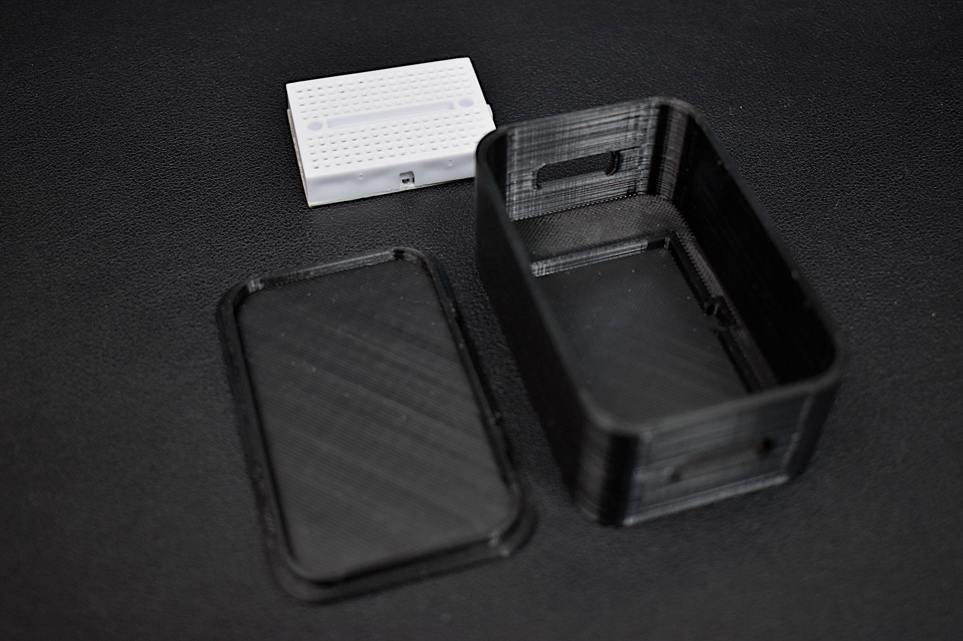
COMPONENTS :
9. Enclosure & Breadboard – The enclosure protects the device from dust, moisture, and harsh weather, while the breadboard allows easy circuit assembly and modifications without soldering.
Use: The enclosure ensures durability by shielding the device from environmental damage, while the breadboard enables quick testing and modification of circuits without permanent connections.

Slide 19
FEATURES
1. Multi-Parameter Measurement
Soil Moisture – Determines water content in soil.
Soil pH – Assesses soil acidity or alkalinity.
Soil Temperature – Monitors temperature for plant growth.
Electrical Conductivity (EC) – Evaluates soil salinity and nutrient levels.
Ambient Temperature & Humidity – Monitors surrounding environmental conditions.
2. Power Efficiency
Rechargeable battery for long-lasting use.
3. Versatile Applications
Ideal for agriculture
land surveying
environmental monitoring.

Slide 20
CONCLUSION
The development of a portable land parameter measuring device powered by machine learning holds significant potential for revolutionizing agricultural practices and environmental monitoring. By providing real-time data and analytical insights, this device can empower farmers, scientists, and researchers to make informed decisions, optimize resource utilization, and contribute to sustainable land management and environmental conservation.

Slide 21
THANK YOU

